Slide 1
Lecture 4
Programming IT Course
GNU C
Working with Functions , Arrays, Characters and Strings
Instructor: Dr. Nguyen Ngoc Truong Minh
Vietnamese German University (VGU), 2014

Slide 2
Lecture 4 - Part 1
C Functions

Slide 3
Lecture Objectives
In this first part, you will learn …
To construct programs modularly from small pieces called functions
The common math functions available in the C Standard Library
To create new user-defined functions
The mechanisms used to pass information between functions
Simulation techniques using random number generation
How to write and use recursive functions, i.e., functions that call themselves

Slide 4
4.1 Introduction
4.2 Program Modules in C
4.3 Math Library Functions
4.4 Functions
4.5 Function Definitions
4.6 Function Prototypes
4.7 Function Call Stack and Activation Records
4.8 Headers
4.9 Calling Functions: Call-by-Value and Call-by-Reference

Slide 5
4.10 Random Number Generation
4.11 Example: A Game of Chance
4.12 Storage Classes
4.13 Scope Rules
4.14 Recursion
4.15 Example Using Recursion: Fibonacci Series
4.16 Recursion vs. Iteration

Slide 6
4.1 Introduction
Divide and conquer
Construct a program from smaller pieces or components
These smaller pieces are called modules
Each piece more manageable than the original program

Slide 7
4.2 Program Modules in C
Functions
Modules in C
Programs combine user-defined functions with library functions
C standard library has a wide variety of functions
Function calls
Invoking functions
Provide function name and arguments (data)
Function performs operations or manipulations
Function returns results
Function call analogy
Boss asks workers to complete task
Workers get information, does task, returns result
Information hiding: boss does not know details

Slide 8
Good Programming Practice 4.1
Familiarize yourself with the rich collection of functions in the C Standard Library.

Slide 9
Software Engineering Observation 4.1
Avoid reinventing the wheel. When possible, use C Standard Library functions instead of writing new functions. This can reduce program development time.

Slide 10
Portability Tip 4.1
Using the functions in the C Standard Library helps to make programs more portable.

Slide 11
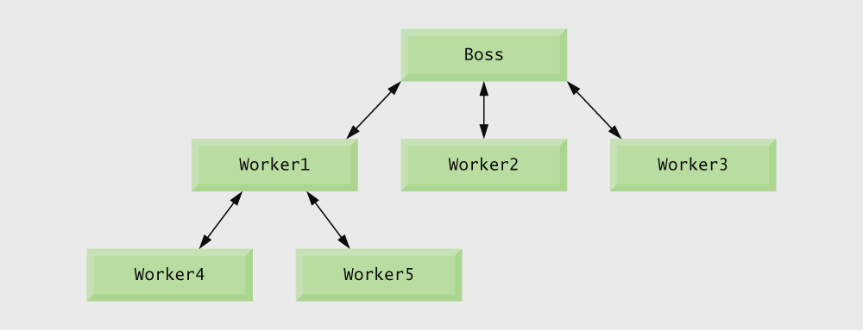
Fig 4.1 | Hierarchical boss function/worker function relationship.

Slide 12
4.3 Math Library Functions
Math library functions
perform common mathematical calculations
#include <math.h>
Format for calling functions
FunctionName( argument );
If multiple arguments, use comma-separated list
printf(“%.2f”, sqrt(900.0));
Calls function sqrt, which returns the square root of its argument
All math functions return data type double
Arguments may be constants, variables, or expressions

Slide 13
Error-Prevention Tip 4.1
Include the math header by using the preprocessor directive #include <math.h> when using functions in the math library.

Slide 14
Fig 4.2 | Commonly used math library functions. (Part 1 of 2)

Slide 15
Fig 4.2 | Commonly used math library functions. (Part 2 of 2)

Slide 16
4.4 Functions
Functions
Modularize a program
All variables defined inside functions are local variables
Known only in function defined
Parameters
Communicate information between functions
Local variables
Benefits of functions
Divide and conquer
Manageable program development
Software reusability
Use existing functions as building blocks for new programs
Abstraction - hide internal details (library functions)
Avoid code repetition

Slide 17
Software Engineering Observation 4.2
In programs containing many functions, main is often implemented as a group of calls to functions that perform the bulk of the program’s work.

Slide 18
Software Engineering Observation 4.3
Each function should be limited to performing a single, well-defined task, and the function name should effectively express that task. This facilitates abstraction and promotes software reusability.

Slide 19
Software Engineering Observation 4.4
If you cannot choose a concise name that expresses what the function does, it is possible that your function is attempting to perform too many diverse tasks. It is usually best to break such a function into several smaller functions.

Slide 20
4.5 Function Definitions
Function definition format
return-value-type function-name( parameter-list ) { declarations and statements; }
function-name: any valid identifier
return-value-type: data type of the result (default int)
void – indicates that the function returns nothing
parameter-list: comma separated list, declares parameters
A type must be listed explicitly for each parameter, unless the parameter is of type int

Slide 21
Function definition format (continued)
return-value-type function-name( parameter-list ) { declarations and statements; }
definitions and statements: function body (block)
Variables can be defined inside blocks (can be nested)
Functions cannot be defined inside other functions
returning control
If nothing returned
return;
or, until reaches right brace
If something returned
return expression;

Slide 22
Good Programming Practice 4.2
Place a blank line between function definitions to separate the functions and enhance program readability.

Slide 23
Outline
Function prototype indicates function will be defined later in the program
Call to square function
Function definition

Slide 24
Common Programming Error 4.1
Omitting the return-value-type in a function definition is a syntax error if the function prototype specifies a return type other than int.

Slide 25
Common Programming Error 4.2
Forgetting to return a value from a function that is supposed to return a value can lead to unexpected errors. The C standard states that the result of this omission is undefined.

Slide 26
Common Programming Error 4.3
Returning a value from a function with a void return type is a syntax error.

Slide 27
Good Programming Practice 4.3
Even though an omitted return type defaults to int, always state the return type explicitly.

Slide 28
Common Programming Error 4.4
Specifying function parameters of the same type as double x, y instead of double x, double y might cause errors in your programs.
The parameter declaration double x, y would actually make y a parameter of type int because int is the default.

Slide 29
Common Programming Error 4.5
Placing a semicolon after the right parenthesis enclosing the parameter list of a function definition is a syntax error.

Slide 30
Common Programming Error 4.6
Defining a function parameter again as a local variable within the function is a syntax error.

Slide 31
Good Programming Practice 4.4
Include the type of each parameter in the parameter list, even if that parameter is of the default type int.

Slide 32
Good Programming Practice 4.5
Although it is not incorrect to do so, do not use the same names for the arguments passed to a function and the corresponding parameters in the function definition. This helps avoid ambiguity.

Slide 33
Common Programming Error 4.7
Defining a function inside another function is a syntax error.

Slide 34
Good Programming Practice 4.6
Choosing meaningful function names and meaningful parameter names makes programs more readable and helps avoid excessive use of comments.

Slide 35
Software Engineering Observation 4.5
A function should generally be no longer than one page. Better yet, functions should generally be no longer than half a page. Small functions promote software reusability.

Slide 36
Software Engineering Observation 4.6
Programs should be written as collections of small functions. This makes programs easier to write, debug, maintain and modify.

Slide 37
Software Engineering Observation 4.7
A function requiring a large number of parameters may be performing too many tasks. Consider dividing the function into smaller functions that perform the separate tasks. The function header should fit on one line if possible.

Slide 38
Software Engineering Observation 4.8
The function prototype, function header and function calls should all agree in the number, type, and order of arguments and parameters, and in the type of return value.

Slide 39
Outline
Function prototype
Function call

Slide 40
Outline
Function definition

Slide 41
4.6 Function Prototypes
Function prototype
Function name
Parameters – what the function takes in
Return type – data type function returns (default int)
Used to validate functions
Prototype only needed if function definition comes after use in program
The function with the prototype
int maximum( int x, int y, int z );
takes in 3 ints
returns an int
Promotion rules and conversions
Converting to lower types can lead to errors

Slide 42
Good Programming Practice 4.7
Include function prototypes for all functions to take advantage of C’s type-checking capabilities.
Use #include preprocessor directives to obtain function prototypes for the standard library functions from the headers for the appropriate libraries, or to obtain headers containing function prototypes for functions developed by you and/or your group members.

Slide 43
Good Programming Practice 4.8
Parameter names are sometimes included in function prototypes for documentation purposes. The compiler ignores these names.

Slide 44
Common Programming Error 4.8
Forgetting the semicolon at the end of a function prototype is a syntax error.

Slide 45
Fig 4.3 | Promotion hierarchy for data types.

Slide 46
Common Programming Error 4.9
Converting from a higher data type in the promotion hierarchy to a lower type can change the data value.

Slide 47
Common Programming Error 4.10
Forgetting a function prototype causes a syntax error if the return type of the function is not int and the function definition appears after the function call in the program. Otherwise, forgetting a function prototype may cause a runtime error or an unexpected result.

Slide 48
Software Engineering Observation 4.9
A function prototype placed outside any function definition applies to all calls to the function appearing after the function prototype in the file. A function prototype placed in a function applies only to calls made in that function.

Slide 49
4.7 Function Call Stack and Activation Records
Program execution stack
A stack is a Last-In, First-Out (LIFO) data structure
Anything put into the stack is placed “on top”
The only data that can be taken out is the data on top
C uses a program execution stack to keep track of which functions have been called
When a function is called, it is placed on top of the stack
When a function ends, it is taken off the stack and control returns to the function immediately below it
Calling more functions than C can handle at once is known as a “stack overflow error”

Slide 50
4.8 Headers
Header files
Contain function prototypes for library functions
<stdlib.h>, <math.h>, etc.
Load with #include <filename>
#include <stdio.h>
#include <math.h>
Custom header files
Create file with functions
Save as filename.h
Load in other files with #include “filename.h”
Reuse functions

Slide 51
Fig 4.4 | Some of the standard library headers. (Part 1 of 3)

Slide 52
Fig 4.4 | Some of the standard library headers. (Part 2 of 3)

Slide 53
Fig 4.4 | Some of the standard library headers. (Part 3 of 3)

Slide 54
4.9 Calling Functions: Call-by-Value and Call-by-Reference
Call-by-value
Copy of argument passed to function
Changes in function do not effect original
Use when function does not need to modify argument
Avoids accidental changes
Call-by-reference
Passes original argument
Changes in function effect original
Only used with trusted functions
For now, we focus on call-by-value

Slide 55
4.10 Random Number Generation
rand function
Load <stdlib.h>
Returns “random” number between 0 and RAND_MAX (at least 32767)
i = rand();
Pseudorandom
Preset sequence of “random” numbers
Same sequence for every function call
Scaling
To get a random number between 1 and n
1 + (rand()%n)
rand()%n returns a number between 0 and n-1
Add 1 to make random number between 1 and n
1 + (rand()%6)
number between 1 and 6

Slide 56
Outline
Generates a random number between 1 and 6

Slide 57
Outline

Slide 58
Outline

Slide 59
Outline

Slide 60
4.10 Random Number Generation
srand function
Load <stdlib.h>
Takes an integer seed and jumps to that location in its “random” sequence
srand( seed );
srand( time(NULL) ); /*load <time.h> */
time( NULL )
Returns the number of seconds that have passed since January 1, 1970
“Randomizes” the seed

Slide 61
Outline
Seeds the rand function

Slide 62
Outline

Slide 63
Common Programming Error 4.11
Using srand in place of rand to generate random numbers.

Slide 64
4.11 Example: A Game of Chance
Craps simulator
Rules
Roll two dices
7 or 11 on first throw, player wins
2, 3, or 12 on first throw, player loses
4, 5, 6, 8, 9, 10 - value becomes player’s “point”
Player must roll his point before rolling 7 to win

Slide 65
Outline
enum (enumeration) assigns numerical values to CONTINUE, WON and LOST

Slide 66
Outline

Slide 67
Outline

Slide 68
Outline

Slide 69
Outline

Slide 70
Common Programming Error 4.12
Assigning a value to an enumeration constant after it has been defined is a syntax error.

Slide 71
Good Programming Practice 4.9
Use only uppercase letters in the names of enumeration constants to make these constants stand out in a program and to indicate that enumeration constants are not variables.

Slide 72
4.12 Storage Classes
Storage class specifiers
Storage duration – how long an object exists in memory
Scope – where object can be referenced in program
Linkage – specifies the files in which an identifier is known
Automatic storage
Object created and destroyed within its block
auto: default for local variables
auto double x, y;
register: tries to put variable into high-speed registers
Can only be used for automatic variables
register int counter = 1;

Slide 73
Performance Tip 4.1
Automatic storage is a means of conserving memory, because automatic variables exist only when they are needed. They are created when the function in which they are defined is entered and they are destroyed when the function is exited.

Slide 74
Software Engineering Observation 4.10
Automatic storage is an example of the principle of least privilege — allowing access to data only when it is absolutely needed. Why have variables stored in memory and accessible when in fact they are not needed?

Slide 75
Performance Tip 4.2
The storage-class specifier register can be placed before an automatic variable declaration to suggest that the compiler maintain the variable in one of the computer’s high-speed hardware registers. If intensely used variables such as counters or totals can be maintained in hardware registers, the overhead of repeatedly loading the variables from memory into the registers and storing the results back into memory can be eliminated.

Slide 76
Performance Tip 4.3
Often, register declarations are unnecessary. Today’s optimizing compilers are capable of recognizing frequently used variables and can decide to place them in registers without the need for a register declaration.

Slide 77
Static storage
Variables exist for entire program execution
Default value of zero
static: local variables defined in functions
Keep value after function ends
Only known in their own function
extern: default for global variables and functions
Known in any function

Slide 78
Software Engineering Observation 4.11
Defining a variable as global rather than local allows unintended side effects to occur when a function that does not need access to the variable accidentally or maliciously modifies it. In general, use of global variables should be avoided except in certain situations with unique performance requirements.

Slide 79
Software Engineering Observation 4.12
Variables used only in a particular function should be defined as local variables in that function rather than as external variables.

Slide 80
Common Programming Error 4.13
Using multiple storage-class specifiers for an identifier. Only one storage-class specifier can be applied to an identifier.

Slide 81
4.13 Scope Rules
File scope
Identifier defined outside function, known in all functions
Used for global variables, function definitions, function prototypes
Function scope
Can only be referenced inside a function body
Used only for labels (start:, case: , etc.)

Slide 82
Block scope
Identifier declared inside a block
Block scope begins at definition, ends at right brace
Used for variables, function parameters (local variables of function)
Outer blocks “hidden” from inner blocks if there is a variable with the same name in the inner block
Function prototype scope
Used for identifiers in parameter list

Slide 83
Common Programming Error 4.14
Accidentally using the same name for an identifier in an inner block as is used for an identifier in an outer block, when in fact you want the identifier in the outer block to be active for the duration of the inner block.

Slide 84
Error-Prevention Tip 4.2
Avoid variable names that hide names in outer scopes. This can be accomplished simply by avoiding the use of duplicate identifiers in a program.

Slide 85
Outline
Global variable with file scope
Variable with block scope
Variable with block scope

Slide 86
Outline
Variable with block scope

Slide 87
Outline
Static variable with block scope
Global variable

Slide 88
Outline

Slide 89
4.14 Recursion
Recursive functions
Functions that call themselves
Can only solve a base case
Divide a problem up into
What it can do
What it cannot do
What it cannot do resembles original problem
The function launches a new copy of itself (recursion step) to solve what it cannot do
Eventually base case gets solved
Gets plugged in, works its way up and solves whole problem

Slide 90
Example: calculate factorials
5! = 5 * 4 * 3 * 2 * 1
Notice that
5! = 5 * 4!
4! = 4 * 3! ...
Can compute factorials recursively
Solve base case (1! = 0! = 1) then plug in
2! = 2 * 1! = 2 * 1 = 2;
3! = 3 * 2! = 3 * 2 = 6;

Slide 91
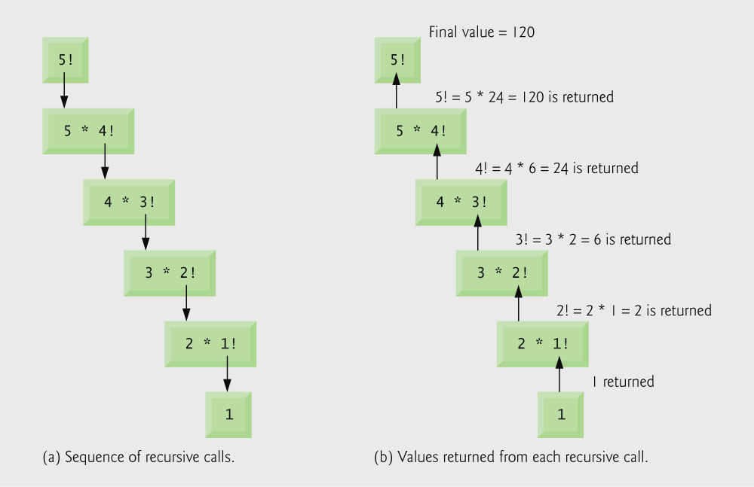
Fig 4.5 | Recursive evaluation of 5!

Slide 92
Outline

Slide 93
Outline

Slide 94
Common Programming Error 4.15
Forgetting to return a value from a recursive function when one is needed.

Slide 95
Common Programming Error 4.16
Either omitting the base case, or writing the recursion step incorrectly so that it does not converge on the base case, will cause infinite recursion, eventually exhausting memory. This is analogous to the problem of an infinite loop in an iterative (non-recursive) solution. Infinite recursion can also be caused by providing an unexpected input.

Slide 96
4.15 Example Using Recursion: Fibonacci Series
Fibonacci series: 0, 1, 1, 2, 3, 5, 8 ...
Each number is the sum of the previous two
Can be solved recursively:
fib( n ) = fib( n - 1 ) + fib( n – 2 )
Code for the fibonacci function
long fibonacci( long n )
{
if (n == 0 || n == 1) // base case
return n;
else
return fibonacci(n - 1) + fibonacci(n – 2);
}

Slide 97
Outline

Slide 98
Outline

Slide 99
Outline

Slide 100
Outline

Slide 101
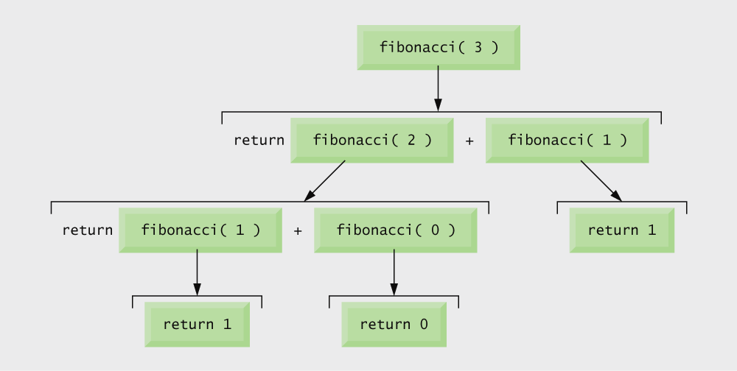
Fig 4.6 | Set of recursive calls for fibonacci(3)

Slide 102
Common Programming Error 4.17
Writing programs that depend on the order of evaluation of the operands of operators other than &&, ||, ?:, and the comma (,) operator can lead to errors because compilers may not necessarily evaluate the operands in the order you expect.

Slide 103
Portability Tip 4.2
Programs that depend on the order of evaluation of the operands of operators other than &&, ||, ?:, and the comma (,) operator can function differently on systems with different compilers.

Slide 104
Performance Tip 4.3
Avoid Fibonacci-style recursive programs which result in an exponential “explosion” of calls.

Slide 105
4.16 Recursion vs. Iteration
Repetition
Iteration: explicit loop
Recursion: repeated function calls
Termination
Iteration: loop condition fails
Recursion: base case recognized
Both can have infinite loops
Balance
Choice between performance (iteration) and good software engineering (recursion)

Slide 106
Software Engineering Observation 4.13
Any problem that can be solved recursively can also be solved iteratively (non-recursively). A recursive approach is normally chosen in preference to an iterative approach when the recursive approach more naturally mirrors the problem and results in a program that is easier to understand and debug. Another reason to choose a recursive solution is that an iterative solution may not be apparent.

Slide 107
Performance Tip 4.4
Avoid using recursion in performance situations. Recursive calls take time and consume additional memory.

Slide 108
Common Programming Error 4.18
Accidentally having a non-recursive function call itself either directly, or indirectly through another function.

Slide 109
Performance Tip 4.5
Functionalizing programs in a neat, hierarchical manner promotes good software engineering. But it has a price. A heavily functionalized program — as compared to a monolithic (i.e., one-piece) program without functions — makes potentially large numbers of function calls, and these consume execution time on a computer’s processor(s). So, although monolithic programs may perform better, they are more difficult to program, test, debug, maintain, and evolve.

Slide 110
Lecture 4 - Part 2
C Arrays

Slide 111
Lecture Objectives
In this second part, you will learn …
To use the array data structure to represent lists and tables of values
To define an array, initialize an array and refer to individual elements of an array
To define symbolic constants
To pass arrays to functions
To use arrays to store, sort and search lists and tables of values
To define and manipulate multiple-subscripted arrays

Slide 112
4.1 Introduction
4.2 Arrays
4.3 Defining Arrays
4.4 Array Examples
4.5 Passing Arrays to Functions
4.6 Sorting Arrays
4.7 Case Study: Computing Mean, Median and Mode Using Arrays
4.8 Searching Arrays
4.9 Multiple-Subscripted Arrays

Slide 113
4.1 Introduction
Arrays
Structures of related data items
Static entity – same size throughout program
Dynamic data structures

Slide 114
4.2 Arrays
Array
Group of consecutive memory locations
Same name and type
To refer to an element, specify:
Array name
Position number
Format:
arrayname[ position number ]
First element at position 0
n-element array named c: c[0], c[1] ... c[n–1]

Slide 115
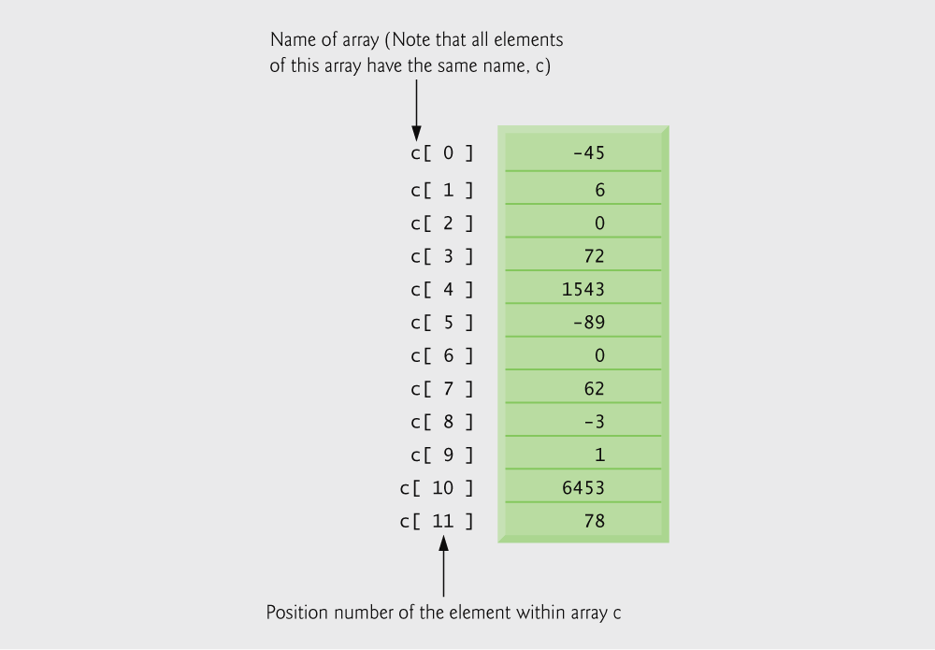
Fig 4.1 | 12-element array

Slide 116
Array elements are like normal variables
c[0] = 3;
printf(“%d”, c[0]);
Perform operations in subscript. If x equals 3:
c[5–2] == c[3] == c[x]

Slide 117
Common Programming Error 4.1
It is important to note the difference between the “seventh element of the array” and “array element seven”. Because array subscripts begin at 0, the “seventh element of the array” has a subscript of 6, while “array element seven” has a subscript of 7 and is actually the eighth element of the array. This is a source of “off-by-one” errors.

Slide 118
Fig 4.2 | Operator precedence

Slide 119
4.3 Defining Arrays
When defining arrays, specify
Name
Type of array
Number of elements
arrayType arrayName[ numberOfElements ];
Examples:
int c[10];
float myArray[3284];
Defining multiple arrays of same type
Format similar to regular variables
Example:
int b[100], x[27];

Slide 120
4.4 Array Examples
Initializers
int n[5] = { 1, 2, 3, 4, 5 };
If not enough initializers, rightmost elements become 0
int n[5] = { 0 }
All elements 0
If too many initializers, a syntax error occurs
C arrays have no bounds checking
If size omitted, initializers determine it
int n[ ] = { 1, 2, 3, 4, 5 };
5 initializers, therefore 5-element array

Slide 121
Outline
for loop initializes each array element separately
for loop outputs all array elements

Slide 122
Outline

Slide 123
Outline
initializer list initializes all array elements simultaneously

Slide 124
Outline

Slide 125
Common Programming Error 4.2
Forgetting to initialize the elements of an array whose elements should be initialized.

Slide 126
Common Programming Error 4.3
Providing more initializers in an array initializer list than there are elements in the array is a syntax error.

Slide 127
Outline
#define directive tells compiler to replace all instances of the word SIZE with 10
SIZE is replaced with 10 by the compiler, so array s has 10 elements
for loop initializes each array element separately

Slide 128
Outline

Slide 129
Common Programming Error 4.4
Ending a #define or #include preprocessor directive with a semicolon. Remember that preprocessor directives are not C statements.

Slide 130
Common Programming Error 4.5
Assigning a value to a symbolic constant in an executable statement is a syntax error. A symbolic constant is not a variable. No space is reserved for it by the compiler as with variables that hold values at execution time.

Slide 131
Software Engineering Observation 4.1
Defining the size of each array as a symbolic constant makes programs more scalable.

Slide 132
Good Programming Practice 4.1
Use only uppercase letters for symbolic constant names. This makes these constants stand out in a program and reminds you that symbolic constants are not variables.

Slide 133
Good Programming Practice 4.2
In multiword symbolic constant names, use underscores to separate the words for readability.

Slide 134
Outline
initializer list initializes all array elements simultaneously
for loop adds each element of the array to variable total

Slide 135
Outline
#define directives create symbolic constants
frequency array is defined with 11 elements
responses array is defined with 40 elements and its elements are initialized
subscript of frequency array is given by value in responses array

Slide 136
Outline

Slide 137
Good Programming Practice 4.3
Strive for program clarity. Sometimes it may be worthwhile to trade off the most efficient use of memory or processor time in favor of writing clearer programs.

Slide 138
Performance Tip 4.1
Sometimes performance considerations far outweigh clarity considerations.

Slide 139
Common Programming Error 4.6
Referring to an element outside the array bounds.

Slide 140
Error-Prevention Tip 4.1
When looping through an array, the array subscript should never go below 0 and should always be less than the total number of elements in the array (size – 1). Make sure the loop-terminating condition prevents accessing elements outside this range.

Slide 141
Error-Prevention Tip 4.2
Programs should validate the correctness of all input values to prevent erroneous information from affecting a program’s calculations.

Slide 142
Outline
nested for loop prints n[ i ] asterisks on the ith line

Slide 143
Outline

Slide 144
Outline
for loop uses one array to track number of times each number is rolled instead of using 6 variables and a switch statement

Slide 145
Outline

Slide 146
4.4 Array Examples
Character arrays
String “first” is really a static array of characters
Character arrays can be initialized using “string literals”
char string1[] = “first”;
Null character ‘\0’ terminates strings
string1 actually has 6 elements
It is equivalent to
char string1[] = { ‘f’, ‘i’, ‘r’, ‘s’, ‘t’, ‘\0’ };
Can access individual characters
string1[3] is character ‘s’
Array name is the address of array, so & not needed for scanf
scanf( “%s”, string2 );
Reads characters until whitespace encountered
Be careful not to write past end of array, as it is possible to do so

Slide 147
Common Programming Error 4.7
Not providing scanf with a character array large enough to store a string typed at the keyboard can result in destruction of data in a program and other runtime errors. This can also make a system susceptible to worm and virus attacks.

Slide 148
Outline
string2 array is defined with one element for each character, so 15 elements including null character \0
for loop prints characters of string1 array with spaces in between

Slide 149
Outline

Slide 150
Performance Tip 4.2
In functions that contain automatic arrays where the function is in and out of scope frequently, make the array static so it is not created each time the function is called.

Slide 151
Outline

Slide 152
Outline
static array is created only once, when staticArrayInit is first called

Slide 153
Outline
automatic array is recreated every time automaticArrayInit is called

Slide 154
Outline

Slide 155
Common Programming Error 4.8
Assuming that elements of a local static array are initialized to zero every time the function in which the array is defined is called.

Slide 156
4.5 Passing Arrays to Functions
Passing arrays
To pass an array argument to a function, specify the name of the array without any brackets
int myArray[24];
myFunction(myArray, 24);
Array size usually passed to function
Arrays passed call-by-reference
Name of array is address of first element
Function knows where the array is stored
Modifies original memory locations
Passing array elements
Passed by call-by-value
Pass subscripted name (i.e., myArray[3]) to function)

Slide 157
Function prototype
void modifyArray( int b[], int arraySize );
Parameter names optional in prototype
int b[] could be written int []
int arraySize could be simply int

Slide 158
Performance Tip 4.3
Passing arrays by reference makes sense for performance reasons. If arrays were passed by value, a copy of each element would be passed. For large, frequently passed arrays, this would be time consuming and would consume considerable storage for the copies of the arrays.

Slide 159
Outline

Slide 160
Software Engineering Observation 4.2
It is possible to pass an array by value.

Slide 161
Outline
Function prototype indicates function will take an array
Array a is passed to modifyArray by passing only its name

Slide 162
Outline
Array element is passed to modifyElement by passing a[3]

Slide 163
Outline

Slide 164
Outline
const qualifier tells compiler that array cannot be changed
Any attempts to modify the array will result in errors

Slide 165
Outline

Slide 166
Software Engineering Observation 4.3
The const type qualifier can be applied to an array parameter in a function definition to prevent the original array from being modified in the function body. This is another example of the principle of least privilege. Functions should not be given the capability to modify an array unless it is absolutely necessary.

Slide 167
4.6 Sorting Arrays
Sorting data
Important computing application
Virtually every organization must sort some data
Bubble sort (sinking sort)
Several passes through the array
Successive pairs of elements are compared
If increasing order (or identical), no change
If decreasing order, elements exchanged
Repeat
Example:
original: 3 4 2 6 7
pass 1: 3 2 4 6 7
pass 2: 2 3 4 6 7
Small elements “bubble” to the top

Slide 168
Performance Tip 4.4
Often, the simplest algorithms perform poorly. Their virtue is that they are easy to write, test and debug. However, more complex algorithms are often needed to realize maximum performance.

Slide 169
Outline

Slide 170
Outline
If any two array elements are out of order, the function swaps them

Slide 171
4.7 Case Study: Computing Mean, Median and Mode Using Arrays
Mean – average
Median – number in middle of sorted list
1, 2, 3, 4, 5
3 is the median
Mode – number that occurs most often
1, 1, 1, 2, 3, 3, 4, 5
1 is the mode

Slide 172
Outline

Slide 173
Outline

Slide 174
Outline
Once the array is sorted, the median will be the value of the middle element

Slide 175
Outline

Slide 176
Outline

Slide 177
Outline

Slide 178
Outline

Slide 179
Outline

Slide 180
4.8 Searching Arrays
Search an array for a key value
Linear search
Simple
Compare each element of array with key value
Useful for small and unsorted arrays

Slide 181
Outline

Slide 182
Outline

Slide 183
Outline
Linear search algorithm searches through every element in the array until a match is found

Slide 184
Binary search
For sorted arrays only
Compares middle element with key
If equal, match found
If key < middle, looks in first half of array
If key > middle, looks in last half
Repeat
Very fast; at most n steps, where 2^{n} > number of elements
30 element array takes at most 5 steps
2⁵ > 30 so at most 5 steps

Slide 185
Outline

Slide 186
Outline

Slide 187
Outline
If value is found, return its index
If value is too high, search the left half of array
If value is too low, search the right half of array

Slide 188
Outline

Slide 189
Outline

Slide 190
Outline

Slide 191
4.9 Multiple-Subscripted Arrays
Multiple subscripted arrays
Tables with rows and columns (m by n array)
Like matrices: specify row, then column
Initialization
int b[ 2 ][ 2 ] = { { 1, 2 }, { 3, 4 } };
Initializers grouped by row in braces
If not enough, unspecified elements set to zero
int b[ 2 ][ 2 ] = { { 1 }, { 3, 4 } };
Referencing elements
Specify row, then column
printf( “%d”, b[ 0 ][ 1 ] );

Slide 192
Common Programming Error 4.9
Referencing a double-subscripted array element as a[x,y] instead of a[x][y]. C interprets a[x,y] as a[y], and as such it does not cause a syntax error.

Slide 193
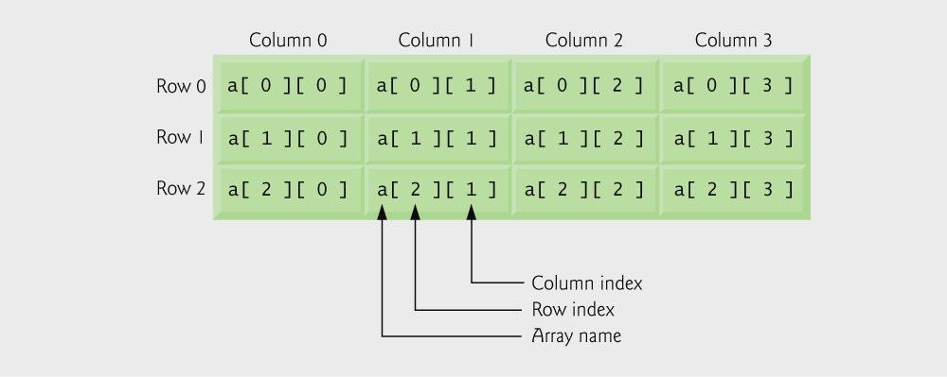
Fig 4.3 | Double-subscripted array with three rows and four columns.

Slide 194
Outline
array1 is initialized with both rows full
array2 and array3 are initialized only partially

Slide 195
Outline

Slide 196
Outline
Each row in the array corresponds to a single student’s set of grades

Slide 197
Outline
average function is passed a row of the array

Slide 198
Outline

Slide 199
Outline

Slide 200
Outline

Slide 201
Outline

Slide 202
Exercises
C Program to Calculate Sum & Average of an Array
C Program to Find the Largest Two Numbers in a given Array
C Program to Sort Elements of An Array in Ascending / Descending Order
Write a C program to Merge and Sort two Different Arrays

Slide 203
Exercises
Write a C program cyclically permutes the elements of an array. This program first accept the input of a five-element array. Then, the program allows the user input the times of permutation. At the end, the program will print out the permuted array (see the example below).
Enter the five elements of the array = 3 40 72 100 68
Enter the times of permutation p = 3
Cyclically permuted numbers are given = 100 68 3 40 72

Slide 204
Lecture 4 - Part 3
C Characters and Strings

Slide 205
Lecture Objectives
In this third part, you will learn …
To use the functions of the character-handling library (ctype)
To use the string-conversion functions of the general utilities library (stdlib)
To use the string and character input/output functions of the standard input/output library (stdio)
To use the string-processing functions of the string handling library (string)
The power of function libraries as a means of achieving software reusability

Slide 206
4.1 Introduction
4.2 Fundamentals of Strings and Characters
4.3 Character-Handling Library
4.4 String-Conversion Functions
4.5 Standard Input/Output Library Functions
4.6 String-Manipulation Functions of the String-Handling Library
4.7 Comparison Functions of the String-Handling Library
4.8 Search Functions of the String-Handling Library
4.9 Memory Functions of the String-Handling Library
4.10 Other Functions of the String-Handling Library

Slide 207
4.1 Introduction
Introduce some standard library functions
Easy string and character processing
Programs can process characters, strings, lines of text, and blocks of memory
These techniques used to make
Word processors
Page layout software
Typesetting programs

Slide 208
4.2 Fundamentals of Strings and Characters
Characters
Building blocks of programs
Every program is a sequence of meaningfully grouped characters
Character constant
An int value represented as a character in single quotes
‘z’ represents the integer value of z
Strings
Series of characters treated as a single unit
Can include letters, digits and special characters (*, /, $)
String literal (string constant) - written in double quotes
“Hello”
Strings are arrays of characters
String a pointer to first character
Value of string is the address of first character

Slide 209
Portability Tip 4.1
When a variable of type char * is initialized with a string literal, some compilers may place the string in a location in memory where the string cannot be modified. If you might need to modify a string literal, it should be stored in a character array to ensure modifiability on all systems.

Slide 210
Common Programming Error 4.1
Not allocating sufficient space in a character array to store the null character that terminates a string is an error.

Slide 211
Common Programming Error 4.2
Printing a “string” that does not contain a terminating null character is an error.

Slide 212
Error-Prevention Tip 4.1
When storing a string of characters in a character array, be sure that the array is large enough to hold the largest string that will be stored. C allows strings of any length to be stored. If a string is longer than the character array in which it is to be stored, characters beyond the end of the array will overwrite data in memory following the array.

Slide 213
String definitions
Define as a character array or a variable of type char *
char color[] = “blue”;
char *colorPtr = “blue”;
Remember that strings represented as character arrays end with ‘\0’
color has 5 elements
Inputting strings
Use scanf
scanf(“%s”, word);
Copies input into word[]
Do not need & (because a string is a pointer)
Remember to leave room in the array for ‘\0’

Slide 214
Common Programming Error 4.3
Processing a single character as a string. A string is a pointer — probably a respectably large integer. However, a character is a small integer (ASCII values range 0–255). On many systems this causes an error, because low memory addresses are reserved for special purposes such as operating-system interrupt handlers — so “access violations” occur.

Slide 215
Common Programming Error 4.4
Passing a character as an argument to a function when a string is expected is a syntax error.

Slide 216
Common Programming Error 4.5
Passing a string as an argument to a function when a character is expected is a syntax error.

Slide 217
8.3 Character Handling Library
Character handling library
Includes functions to perform useful tests and manipulations of character data
Each function receives a character (an int) or EOF as an argument
The following slides contain a table of all the functions in <ctype.h>

Slide 218
Fig 4.1 | Character-handling library functions. (Part 1 of 2.)

Slide 219
Fig 4.1 | Character-handling library functions. (Part 2 of 2.)

Slide 220
Error-Prevention Tip 4.2
When using functions from the character-handling library, include the <ctype.h> header.

Slide 221
Outline
isdigit tests if a character is a decimal digit
isalpha tests if a character is a letter

Slide 222
Outline
isdigit tests if a character is a decimal digit or a letter
isxdigit tests if a character is a hexadecimal digit

Slide 223
Outline

Slide 224
Outline
islower tests if a character is a lowercase letter
isupper tests if a character is an uppercase letter

Slide 225
Outline
toupper and tolower convert letters to upper or lower case

Slide 226
Outline
isspace tests if a character is a whitespace character
iscntrl tests if a character is a control character

Slide 227
Outline
ispunct tests if a character is a punctuation character
isprint tests if a character is a printing character

Slide 228
Outline
isgraph tests if a character is a printing character that is not a space

Slide 229
8.4 String-Conversion Functions
Conversion functions
In <stdlib.h> (general utilities library)
Convert strings of digits to integer and floating-point values

Slide 230
Fig 4.5 | String-conversion functions of the general utilities library.

Slide 231
Error-Prevention Tip 4.3
When using functions from the general utilities library, include the <stdlib.h> header.

Slide 232
Outline
atof converts a string to a double

Slide 233
Outline
atoi converts a string to an int

Slide 234
Outline
atol converts a string to a long

Slide 235
Outline
strtod converts a piece of a string to a double

Slide 236
Outline
strtol converts a piece of a string to a long

Slide 237
Outline
strtoul converts a piece of a string to an unsigned long

Slide 238
4.5 Standard Input/Output Library Functions
Functions in <stdio.h>
Used to manipulate character and string data

Slide 239
Fig 4.12 | Standard input/output library character and string functions.

Slide 240
Error-Prevention Tip 4.4
When using functions from the standard input/output library, include the <stdio.h> header.

Slide 241
Outline
gets reads a line of text from the user

Slide 242
Outline
putchar prints a single character on the screen

Slide 243
Outline
puts prints a line of text on the screen
getchar reads a single character from the user

Slide 244
Outline

Slide 245
Outline
sprintf prints a line of text into an array like printf prints text on the screen

Slide 246
Outline
sscanf reads a line of text from an array like scanf reads text from the user

Slide 247
4.6 String Manipulation Functions of the String Handling Library
String handling library has functions to
Manipulate string data
Search strings
Tokenize strings
Determine string length

Slide 248
Fig 4.17 | String-manipulation functions of the string-handling library.

Slide 249
Portability Tip 4.2
Type size_t is a system-dependent synonym for either type unsigned long or type unsigned int.

Slide 250
Error-Prevention Tip 4.5
When using functions from the string-handling library, include the <string.h> header.

Slide 251
Common Programming Error 4.6
Not appending a terminating null character to the first argument of a strncpy when the third argument is less than or equal to the length of the string in the second argument.

Slide 252
Outline
strcpy copies string x into character array y
strncpy copies 14 characters of string x into character array z
Note that strncpy does not automatically append a null character

Slide 253
Outline
strcat adds the characters of string s2 to the end of string s1
strncat adds the first 6 characters of string s1 to the end of string s3

Slide 254
Outline

Slide 255
4.7 Comparison Functions of the String-Handling Library
Comparing strings
Computer compares numeric ASCII codes of characters in string
Appendix D has a list of character codes

Slide 256
Fig 4.20 | String-comparison functions of the string-handling library.

Slide 257
Outline
strcmp compares string s1 to string s2

Slide 258
Outline
strncmp compares the first 6 characters of string s1 to the first 6 characters of string s3

Slide 259
Common Programming Error 4.7
Assuming that strcmp and strncmp return 1 when their arguments are equal is a logic error. Both functions return 0 (strangely, the equivalent of C’s false value) for equality.
Therefore, when testing two strings for equality, the result of function strcmp or strncmp should be compared with 0 to determine if the strings are equal.

Slide 260
Portability Tip 4.3
The internal numeric codes used to represent characters may be different on different computers.

Slide 261
Fig 4.22 | String-manipulation functions of the string-handling library. (Part 1 of 2.)

Slide 262
Fig 4.22 | String-manipulation functions of the string-handling library. (Part 2 of 2.)

Slide 263
Outline
strchr searches for the first instance of character1 in string

Slide 264
Outline

Slide 265
Outline
strcspn returns the length of the initial segment of string1 that does not contain any characters in string2

Slide 266
Outline
strpbrk returns a pointer to the first appearance in string1 of any character from string2

Slide 267
Outline
strrchr returns the remainder of string1 following the last occurrence of the character c

Slide 268
Outline
strspn returns the length of the initial segment of string1 that contains only characters from string2

Slide 269
Outline
strstr returns the remainder of string1 following the last occurrence of string2

Slide 270
Outline
strtok “tokenizes” string by breaking it into tokens at each space
Calling strtok again and passing it NULL continues the tokenizing of the previous string

Slide 271
Outline

Slide 272
4.9 Memory Functions of the String-Handling Library
Memory Functions
In <stdlib.h>
Manipulate, compare, and search blocks of memory
Can manipulate any block of data
Pointer parameters are void *
Any pointer can be assigned to void *, and vice versa
void * cannot be dereferenced
Each function receives a size argument specifying the number of bytes (characters) to process

Slide 273
Fig 4.30 | Memory functions of the string-handling library.

Slide 274
Common Programming Error 4.8
String-manipulation functions other than memmove that copy characters have undefined results when copying takes place between parts of the same string.

Slide 275
Outline
memcpy copies the first 17 characters from object s2 into object s1

Slide 276
Outline
memmove copies the first 10 characters from x[5] into object x by means of a temporary array

Slide 277
Outline
memcmp compares the first 4 characters of objects s1 and s2

Slide 278
Outline
memchr locates the first occurrence of the character r inside the first 16 characters of object s

Slide 279
Outline
memset copies the character b into the first 7 characters of object string1

Slide 280
Fig 4.36 | Other functions of the string-handling library.

Slide 281
Outline
strerror returns an error message based on the number passed to it

Slide 282
Portability Tip 4.4
The message generated by strerror is system dependent.

Slide 283
Outline
strlen returns the length of string1

Slide 284
End of this Tutorial

